Slide 1
Configuring and Managing Storage

Slide 2
Partitioning
The process of dividing a disk into logical areas that can be worked with separately is called partitioning. Disk partitioning is done to subdivide the disk into pieces for different purposes.
There are several reasons to use partitioning:
multiple operating systems on the same disk.
different file systems on different partitions.
more efficient disk space management.
different security settings on different partitions.
easier backup procedure.

Slide 3
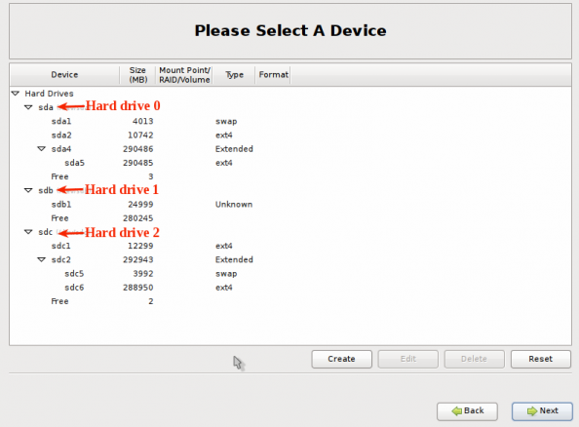

Slide 4
Partitions and Logical Volumes
Partitions offer a rather static way to configure storage on a server.
Logical volumes offer a much more dynamic way to configure storage
The Logical Volume Manager (LVM) offers many benefits:
LVM makes resizing of volumes possible.
In LVM, you can work with snapshots, which are useful in making a reliable backup.
In LVM, you can easily replace failing storage devices.

Slide 5
Creating Partitions
Two ways to create and manage partitions
The graphical Palimpsest tool, which you can start by selecting Applications -> System Tools ->Disk Utility
working with fdisk on the command line

Slide 6
Creating a partition with fdisk
We can create three kinds of partitions:
Primary Partitions: These are written directly to the master boot record of your hard drive. After creating four primary partitions, you can’t add any more partitions.
Extended Partition: Every hard drive can have one extended partition. You cannot create a file system in an extended partition. You can create logical partitions

Slide 7
Logical Partitions: A logical partition is created inside an extended partition. You can have a maximum of 11 logical partitions per disk, and you can create file systems on top of logical partitions.
Select a partition type:
83 This is the default partition type.
82 The partition is used as swap space
5 It is an extended partition
8e Use this partition type if you want to use the partition as an LVM physical volume

Slide 8
Creating Partitions
Creating three partitions: a primary partition, an extended partition, one logical partition
work with an external medium, which is known to this server as /dev/sdb
Insert the USB flash drive that you want to use with your server.
Open a root shell, and type the command dmesg. You should see messages indicating that a new device has been found. You can see that the name of this device is sdb.

Slide 9
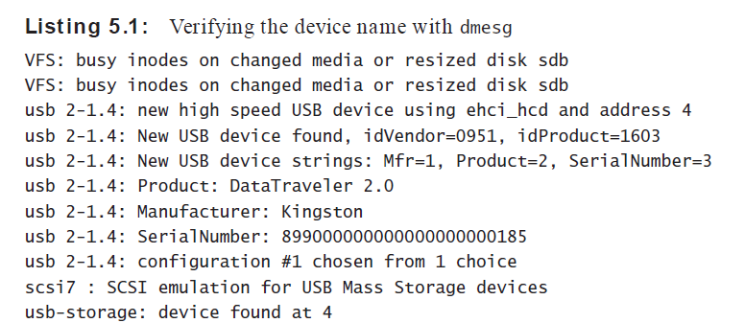

Slide 10
2. use the following command to wipe out its contents completely:
dd if=/dev/zero of=/dev/sdb.
3. Use fdisk -cu /dev/sdb to open fdisk on the device, and create new partitions on it
4. type m to see an overview of all commands that are available in fdisk

Slide 11
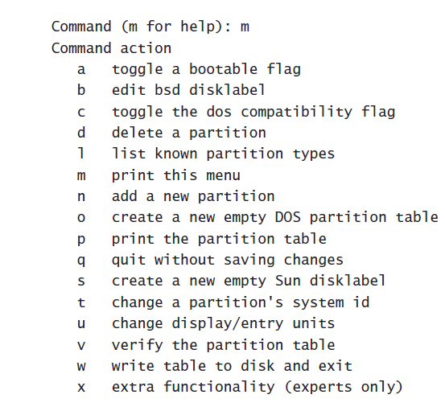

Slide 12
Type n to indicate you want to create a new partition. fdisk then asks you to Choose between a primary and an extended partition. Type p for primary.
Now you Enter a partition number. Because there are no partitions currently on the USB flash drive, you can use partition 1.
Enter the first sector of the partition. Press Enter to accept the default value of sector 2048.
The last sector, type +256M and press Enter. At this point, you have created the new partition,
Type p to print a list of current partitions.

Slide 13
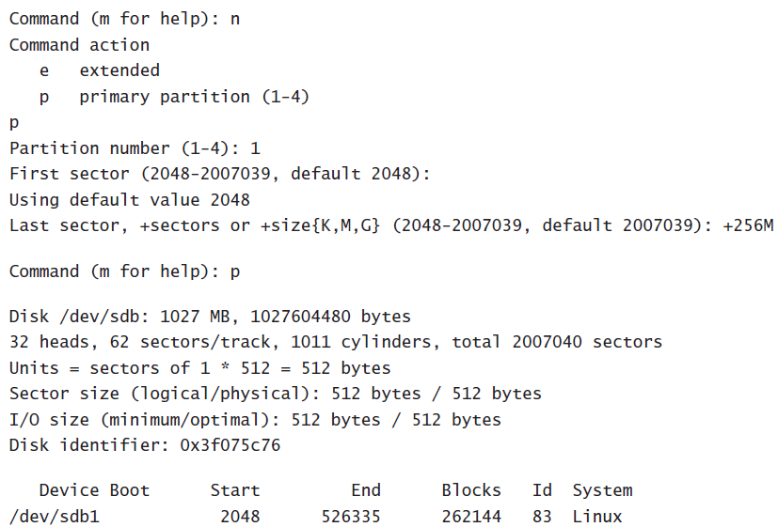

Slide 14
Create an extended partition with a logical partition inside.
Type n again to add this new partition.
Choose option e to indicate that you want to add an extended partition.
Enter partition number, enter 2.
Next press Enter to accept the default starting sector that fdisk suggests for this partition.
When asked for the last sector, hit Enter to accept the default.
You have now created the extended partition.

Slide 15
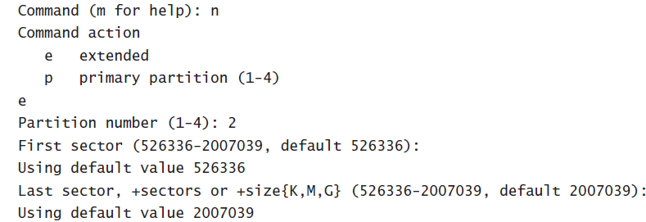

Slide 16
Creating logical partitions
press n again from the fdisk interface to add another partition.
fdisk displays two different options:
p to create another primary partition
l to create a logical partition.
Enter l to create a logical partition. When asked for the first sector to use, press Enter.
Next enter +100M to specify the size of the partition

Slide 17
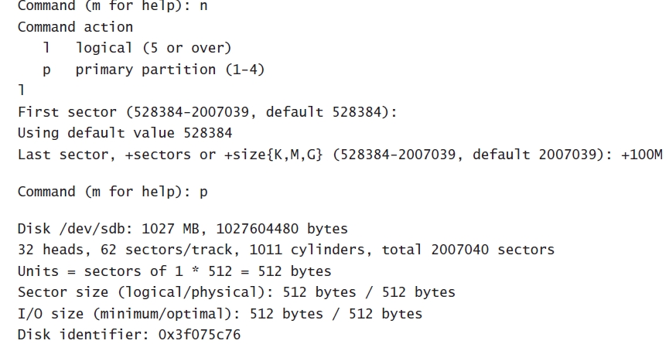
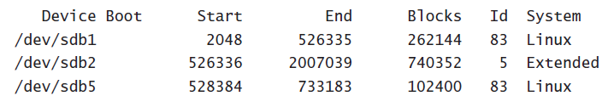

Slide 18
Creating File Systems
S.No | File system | Use
1 | Ext4 | The default file system on RHEL. general-purpose file system
2 | Ext2/3 | it is a good choice for very small partitions (less than 100MB).
3 | XFS | XFS must be purchased separately. It offers good performance for very large file systems and very large files
4 | Btrfs | B-tree database, which makes the file system faster. It also has cool features like Copy on Write
5 | VFAT and MS-DOS | It is useful to put files on a USB drive to exchange them among Windows users
6 | GFS | GFS is Red Hat ’s Global File System. It is designed for use in high availability clusters where multiple nodes need to be able to write to the same file system simultaneously.

Slide 19
one file system feature is— file system journal
The journal works as a transaction log in which the file system keeps records of files that are open for modification at any given time.
if the server crashes we can see files are potentially damaged, file system journal comes as rescue.
a file system journal takes up disk space—an average of 50MB normally on Ext4

Slide 20
Creating File Systems
use the mkfs utility
To create an ext4 file system, you use the mkfs.ext4 command, the command
mkfs -t ext4

Slide 21
Creating a File System
Use the fdisk -cul /dev/sdb command to generate a list of all partitions that currently exist on the /dev/sdb device.
Check there is nothing already on the partition
use the command mount /dev/sdb1 /mnt. If this command fails, everything is good.
use mkfs.ext4 /dev/sdb1 to format the sdb1 device
use mount /dev/sdb1 /mnt to check that you can mount it.

Slide 22
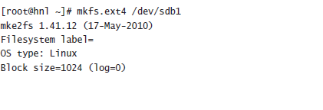
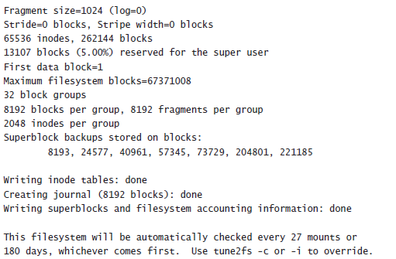

Slide 23
Changing File System Properties
tune2fs -command allows you to change properties
Dumpe2fs - you can check the properties that are currently in use.
The fsck command has a few useful options. With the -p option, which attempts to perform an automatic repair

Slide 24
Ext file system properties
S.No | Property | Use
1 | -c max_mounts_count | to force a periodic check is by setting the maximum mount count
2 | -i interval | Setting a maximum mount count
3 | -m reserved_blocks_percent | By default, 5 percent of an Ext file system is reserved for the user root
4 | -L volume_label | You can create a file system label, which is a name that is in the file system.
5 | -o mount_options | -o option-name

Slide 25
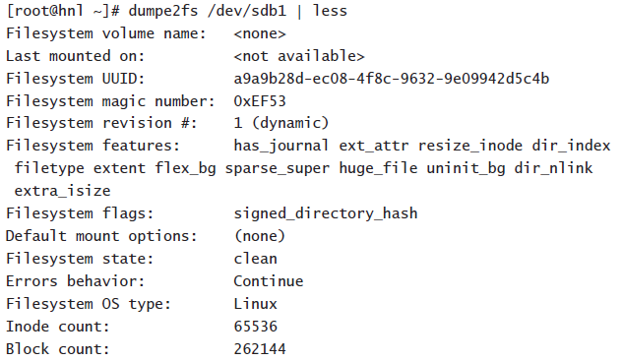
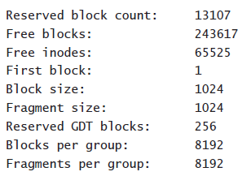

Slide 26
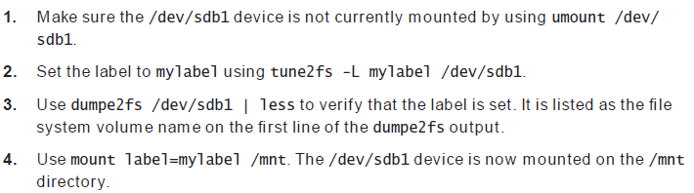
Setting a File System Label

Slide 27
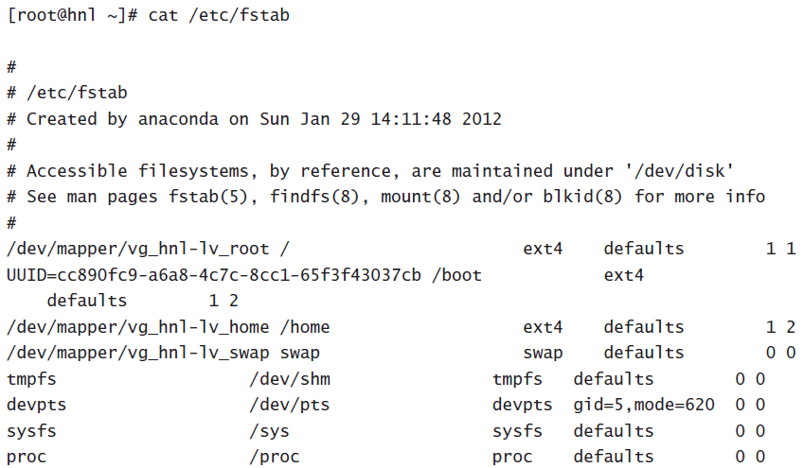
Mounting File Systems Automatically through fstab

Slide 28
The /etc/fstab file is used to mount two different kinds of devices:
you can mount file systems and system devices
To specify how the mounts should be performed, six different columns are used:
The name of the device to be mounted.
The directory where this device should be mounted.
The file system that should be used to mount the device.
Specific mount options: use defaults if you want to perform the mount without any specific options.
Dump support: use 1 if you want the dump backup utility to be able to make a backup of this device, and use 0 if you don’t.
fsck support: use 0 if you want the file system to be checked automatically while booting. Use 1 for the root file system.. Use 2 for all other file systems

Slide 29
Red Hat Enterprise Linux partitions are normally mounted by using the UUID that is assigned to every partition.
To find out the UUIDs of the devices on your server, you can use the blkid command.

Slide 30
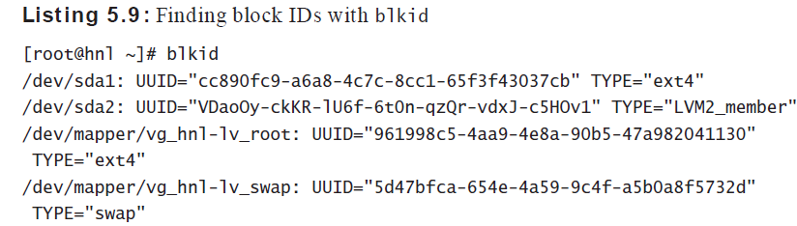

Slide 31
Working with Logical Volumes
Creating Logical Volumes
To create logical volumes, you set up three different parts
physical volume (PV).-The physical volume is the actual storage device you want to use in your LVM configuration , use pvcreate
volume group (VG). -The volume group is the collection of all the storage devices you want to use in an LVM configuration, use vgcreate

Slide 32
Creating the LVM volumes-use the lvcreate command
lvcreate -n myvol -L 100M mygroup , which creates a 100MB volume in the group mygroup.

Slide 33
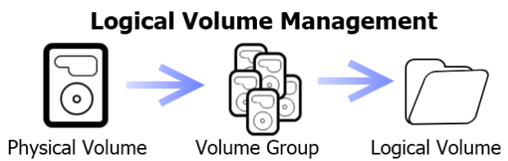
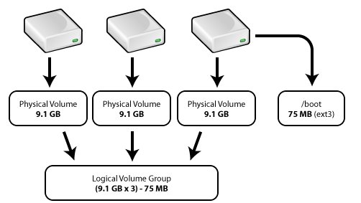
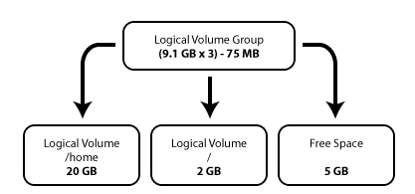

Slide 34
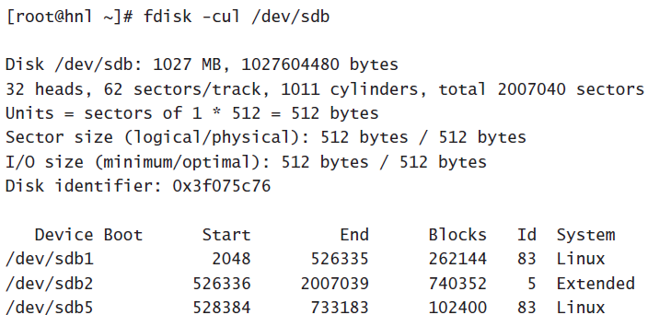
Creating LVM Logical Volumes
From a root shell, type fdisk -cul /dev/sdb. This should show the current partitioning of /dev/sdb

Slide 35
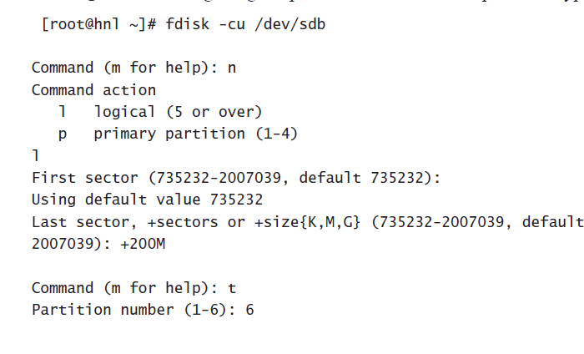

Slide 36
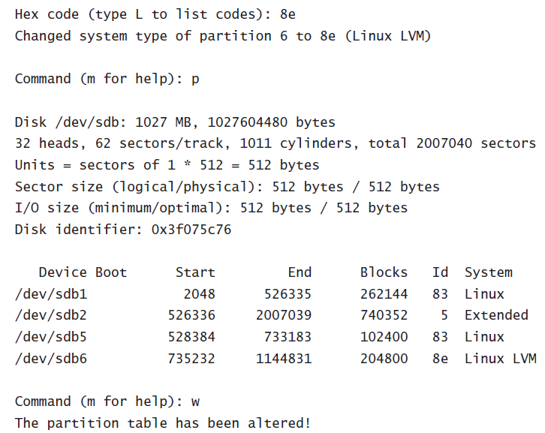

Slide 37
Use pvcreate /dev/sdb to convert it into an LVM physical volume.
To create a volume group use the command vgcreate usbvg /dev/sdb6.
use lvcreate -n usbvol -L 100M usbvg. This creates a logical volume that uses 50 percent of available disk space in the volume group
To confirm that the logical volume has been created successfully, you can type the lvs command

Slide 38
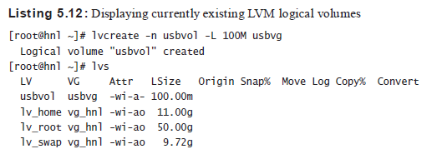

Slide 39
Resizing Logical Volumes
The three common scenarios for resizing a logical volume are as follows:
Extending a logical volume if there are still unallocated extents in the volume group.
Extending a logical volume if there are no longer any unallocated extents in the volume group. Then you’ll need to extend the volume group first.
Shrinking a logical volume.

Slide 40
Resizing Logical Volumes
When resizing logical volumes, you always have you always have to resize the file system that is on it
To resize any Ext file system (Ext2, Ext3, or Ext4), you can use resize2fs
The system-config-lvm tool allows you to manage LVM from a graphical interface.

Slide 41
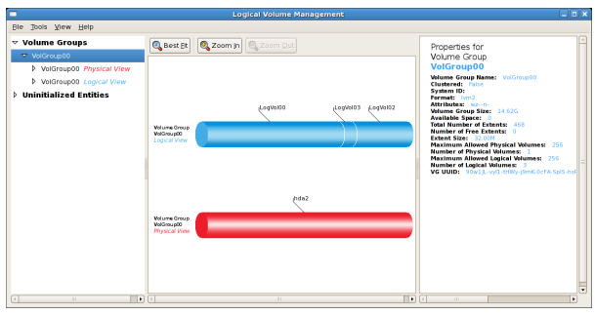

Slide 42
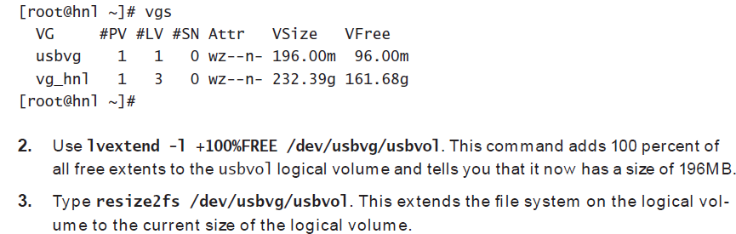
Extending a Logical Volume

Slide 43
Working with Snapshots
Using an LVM snapshot allows you to freeze the current state of an LVM volume.
Creating a snapshot allows you to keep the current state of a volume and gives you an easy option for reverting to this state later
If you no longer need the snapshot, you can delete it using the lvremove command

Slide 44
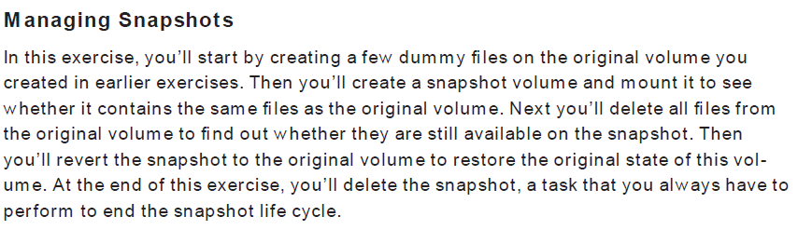

Slide 45
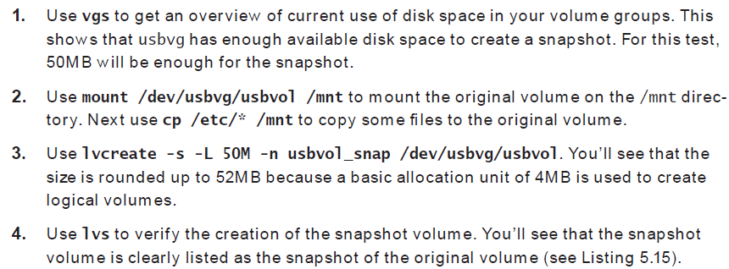

Slide 46
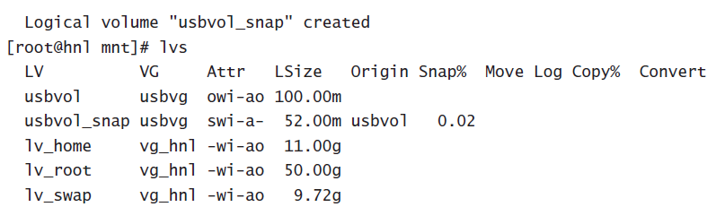

Slide 47
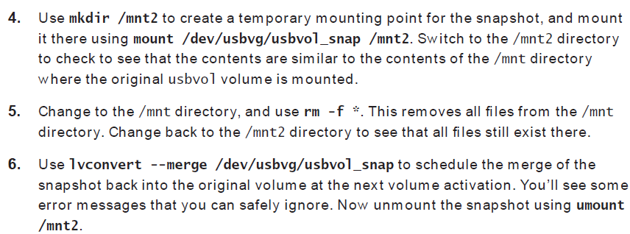

Slide 48
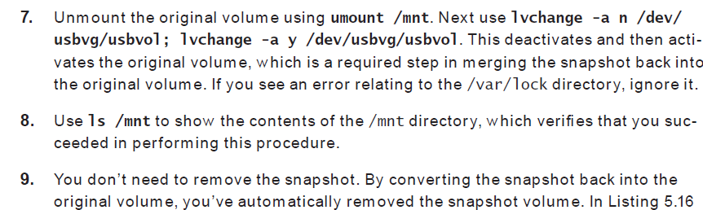

Slide 49
Creating Swap Space
Swap space is allocated when your server is completely out of memory, and using swap space allows your server to continue to offer its services.
Make sure to create a device you’re going to use as the swap device
Use mkswap to format the swap device
Use swapon to activate the swap space
Create a line in /etc/fstab to activate the swap space automatically the next time you reboot your server.

Slide 50
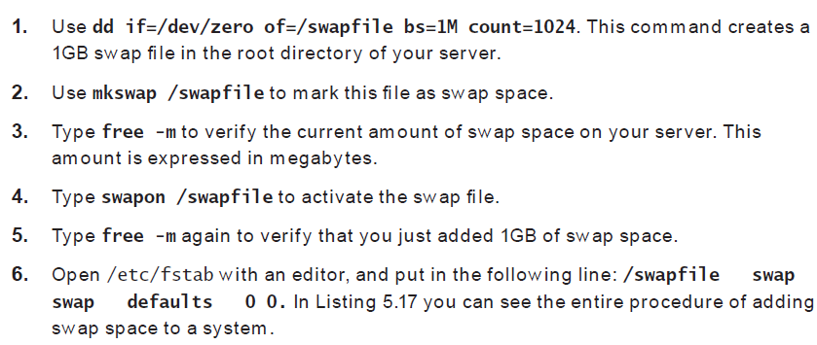

Slide 51
Working with Encrypted Volumes
Use LUKS (Linux Unified Key Setup) to create an encrypted volume.
First you’ll need to create the device you want to encrypt. This can be an LVM logical volume or a partition.
2.After creating the device, you need to format it as an encrypted device. To do that, use the cryptsetup luksFormat /dev/yourdevice command.

Slide 52
3. Once the device is formatted as an encrypted device, you need to open it before you can do anything with it. When opening it, you assign a name to the encrypted device.
This name occurs in the /dev/mapper directory
cryptsetup luksOpen /dev/yourdevice cryptdevicename
4. create a file system on it. To do this, use mkfs:
mkfs.ext4 /dev/mapper/cryptdevicename

Slide 53
5.mount the encrypted device and put files on it. Use command
mount /dev/ mapper/cryptdevicename /somewhere
6.After using the encrypted device, use umount to unmount.
7.To close it
cryptsetup luksClose cryptdevicename

Slide 54
https://forms.gle/KS6i2Z4RwS6bBEhz5
https://forms.gle/xmfbG7b9yp6KnPUC9
https://forms.gle/Sn31USGg2gEn9nAQA

